Slide 1

Smart Form Assistant
BY: Hrudai Aditya

Slide 2
Action-wise use cases:
CLIENT | SYSTEM
LOGIN | Takes your mail id and password key
Upload PHOTO | Analyzes the photos and particular text with name fields
Upload WORD doc | Parses the name fields into text
Number Of Forms | Stores the details in the system memory
Form Addresses | Stores the address of the forms to be filled
Generate | Complies the text from the photo/word into given name fields in the forum
Randomize | To generate random sets of data forms for scientific purpose

Slide 3
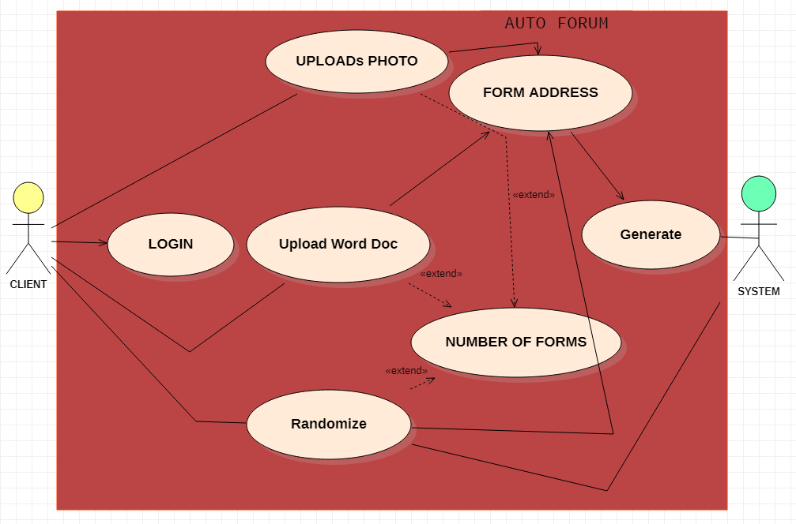
USE CASE DIAGRAM
VOICE
Headings

Slide 4
Use Case Descriptions
CLIENT | SYSTEM
 | 1.LOGIN with credentials
2.Uploads Photo
 | 3..Parses the photo data into text
4.Enters Form address
 | 5.Genrate:FIlls the form from the text in word
Use Case 1
NAME: Upload Photo
Actors:Client,System
Description: Translates the names fields present in photo to text
Pre-Condition: Clear photo uploaded
Post-Condition: Form saved

Slide 5
Use Case Descriptions
CLIENT | SYSTEM
 | 1.LOGIN with credentials
2.Voice
 | 3..Parses the voice into text
4.Enters Form address
 | 5.Genrate:FIlls the form
Use Case 2
Name: Voice
Actors:Client,System
Description: Translates the names fields present in word to text
Pre-Condition: Clear Voice
Post-Condition: Form saved

Slide 6
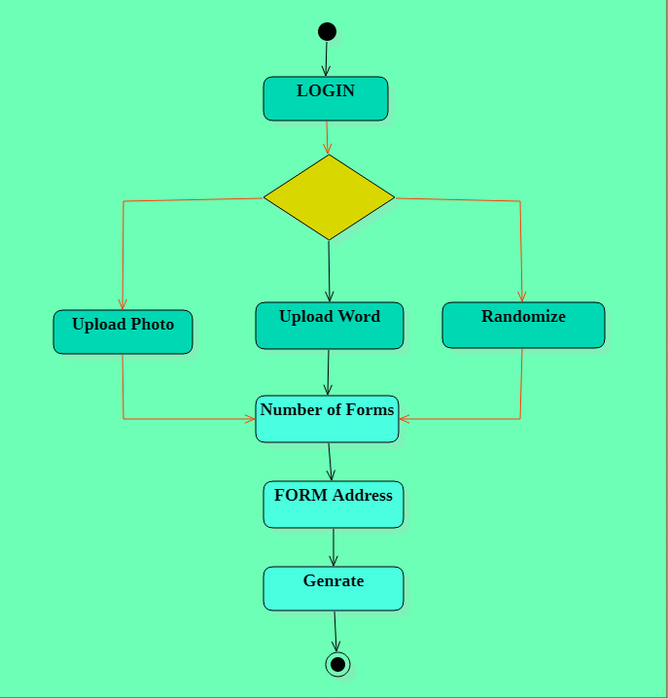
Activity Diagram:
Voice
Headings

Slide 7

Thank you

